Slide 1





Data Wise Solutions
CROP PRICE
PREDICTION

Slide 2



TABLE OF CONTENT
INTRODUCTION
EXPLORATORY DATA ANALYSIS
BUSINESS UNDERSTANDING
FEATURE ENGINEERING
STAKEHOLDERS
MACHINE LEARNING MODELS
PROBLEM STATEMENT
CONCLUSIONS
OBJECTIVES
RECOMMENDATIONS

Slide 3

INTRODUCTION
OVERVIEW
Datawise Solutions specialises in cutting-edge data analytics and consulting services to help organisations leverage the value of their data. With a team of professional data scientists, analysts, and consultants, we aim to assist organizations in gaining insights, making informed decisions, and driving growth.
Our goal is to transform raw data into actionable intelligence, whether it's streamlining operations, enhancing marketing strategies, improving customer experiences, or fostering innovation. We offer a range of services, from data collection and cleansing to advanced analytics and predictive modeling, tailored to meet your specific needs.
Through a collaborative approach, we ensure a deep understanding of your business objectives to deliver solutions that yield tangible results. Datawise Solutions believes in the limitless power of data and is committed to being your trusted partner on the journey to data-driven success. Explore the possibilities with us today!

Slide 4
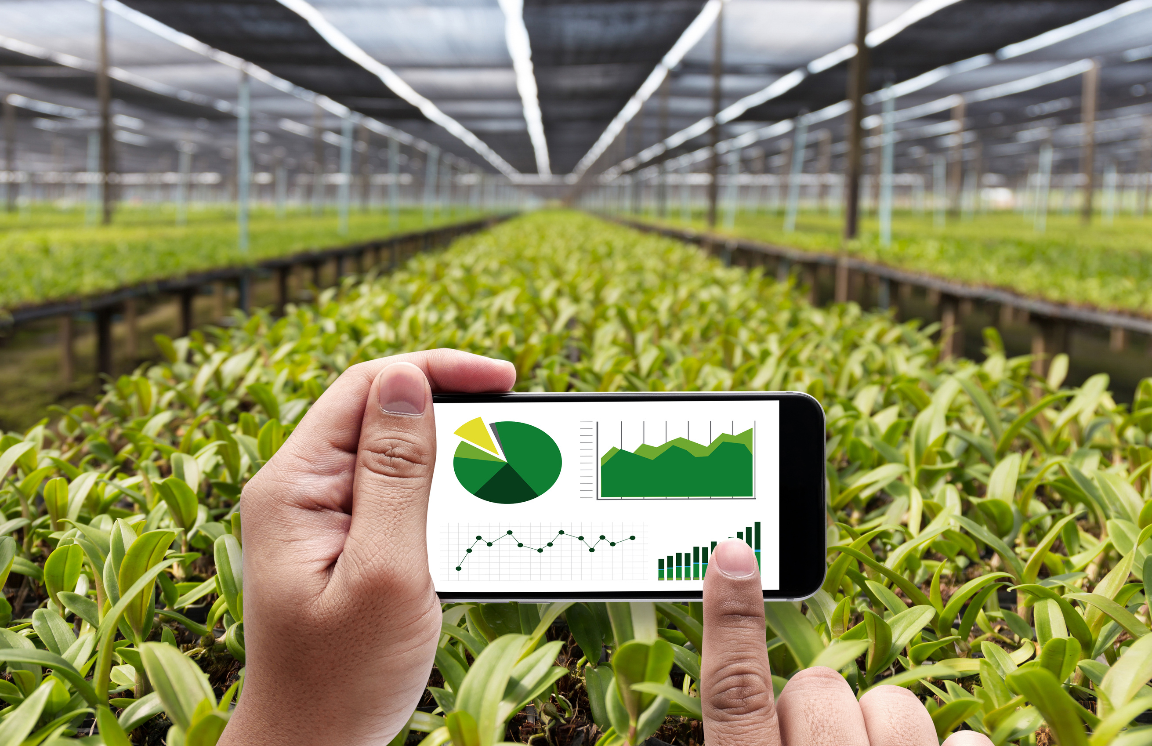

BUSINESS UNDERSTANDING
Kenya's agricultural sector, where farmers earn less while consumers pay more for food products. This discrepancy is largely due to an inefficient market structure and the role of intermediaries, who create a wide gap between the prices farmers receive and what consumers pay.
These middlemen significantly influence market dynamics, leading to a divergence in wholesale and retail prices in Kenyan markets. External factors, such as subsidy schemes and currency fluctuations, further impact the prices of farmers' commodities. Despite these influences, farmers continue to earn less than the market price set in Kenyan stores and markets.
Research by the Kenya Agricultural Research Institute (KARI) further underscores this issue, indicating a decline in agricultural productivity due to limited market access. This situation calls for urgent measures to improve market efficiency and ensure fair pricing for both farmers and consumers.

Slide 5
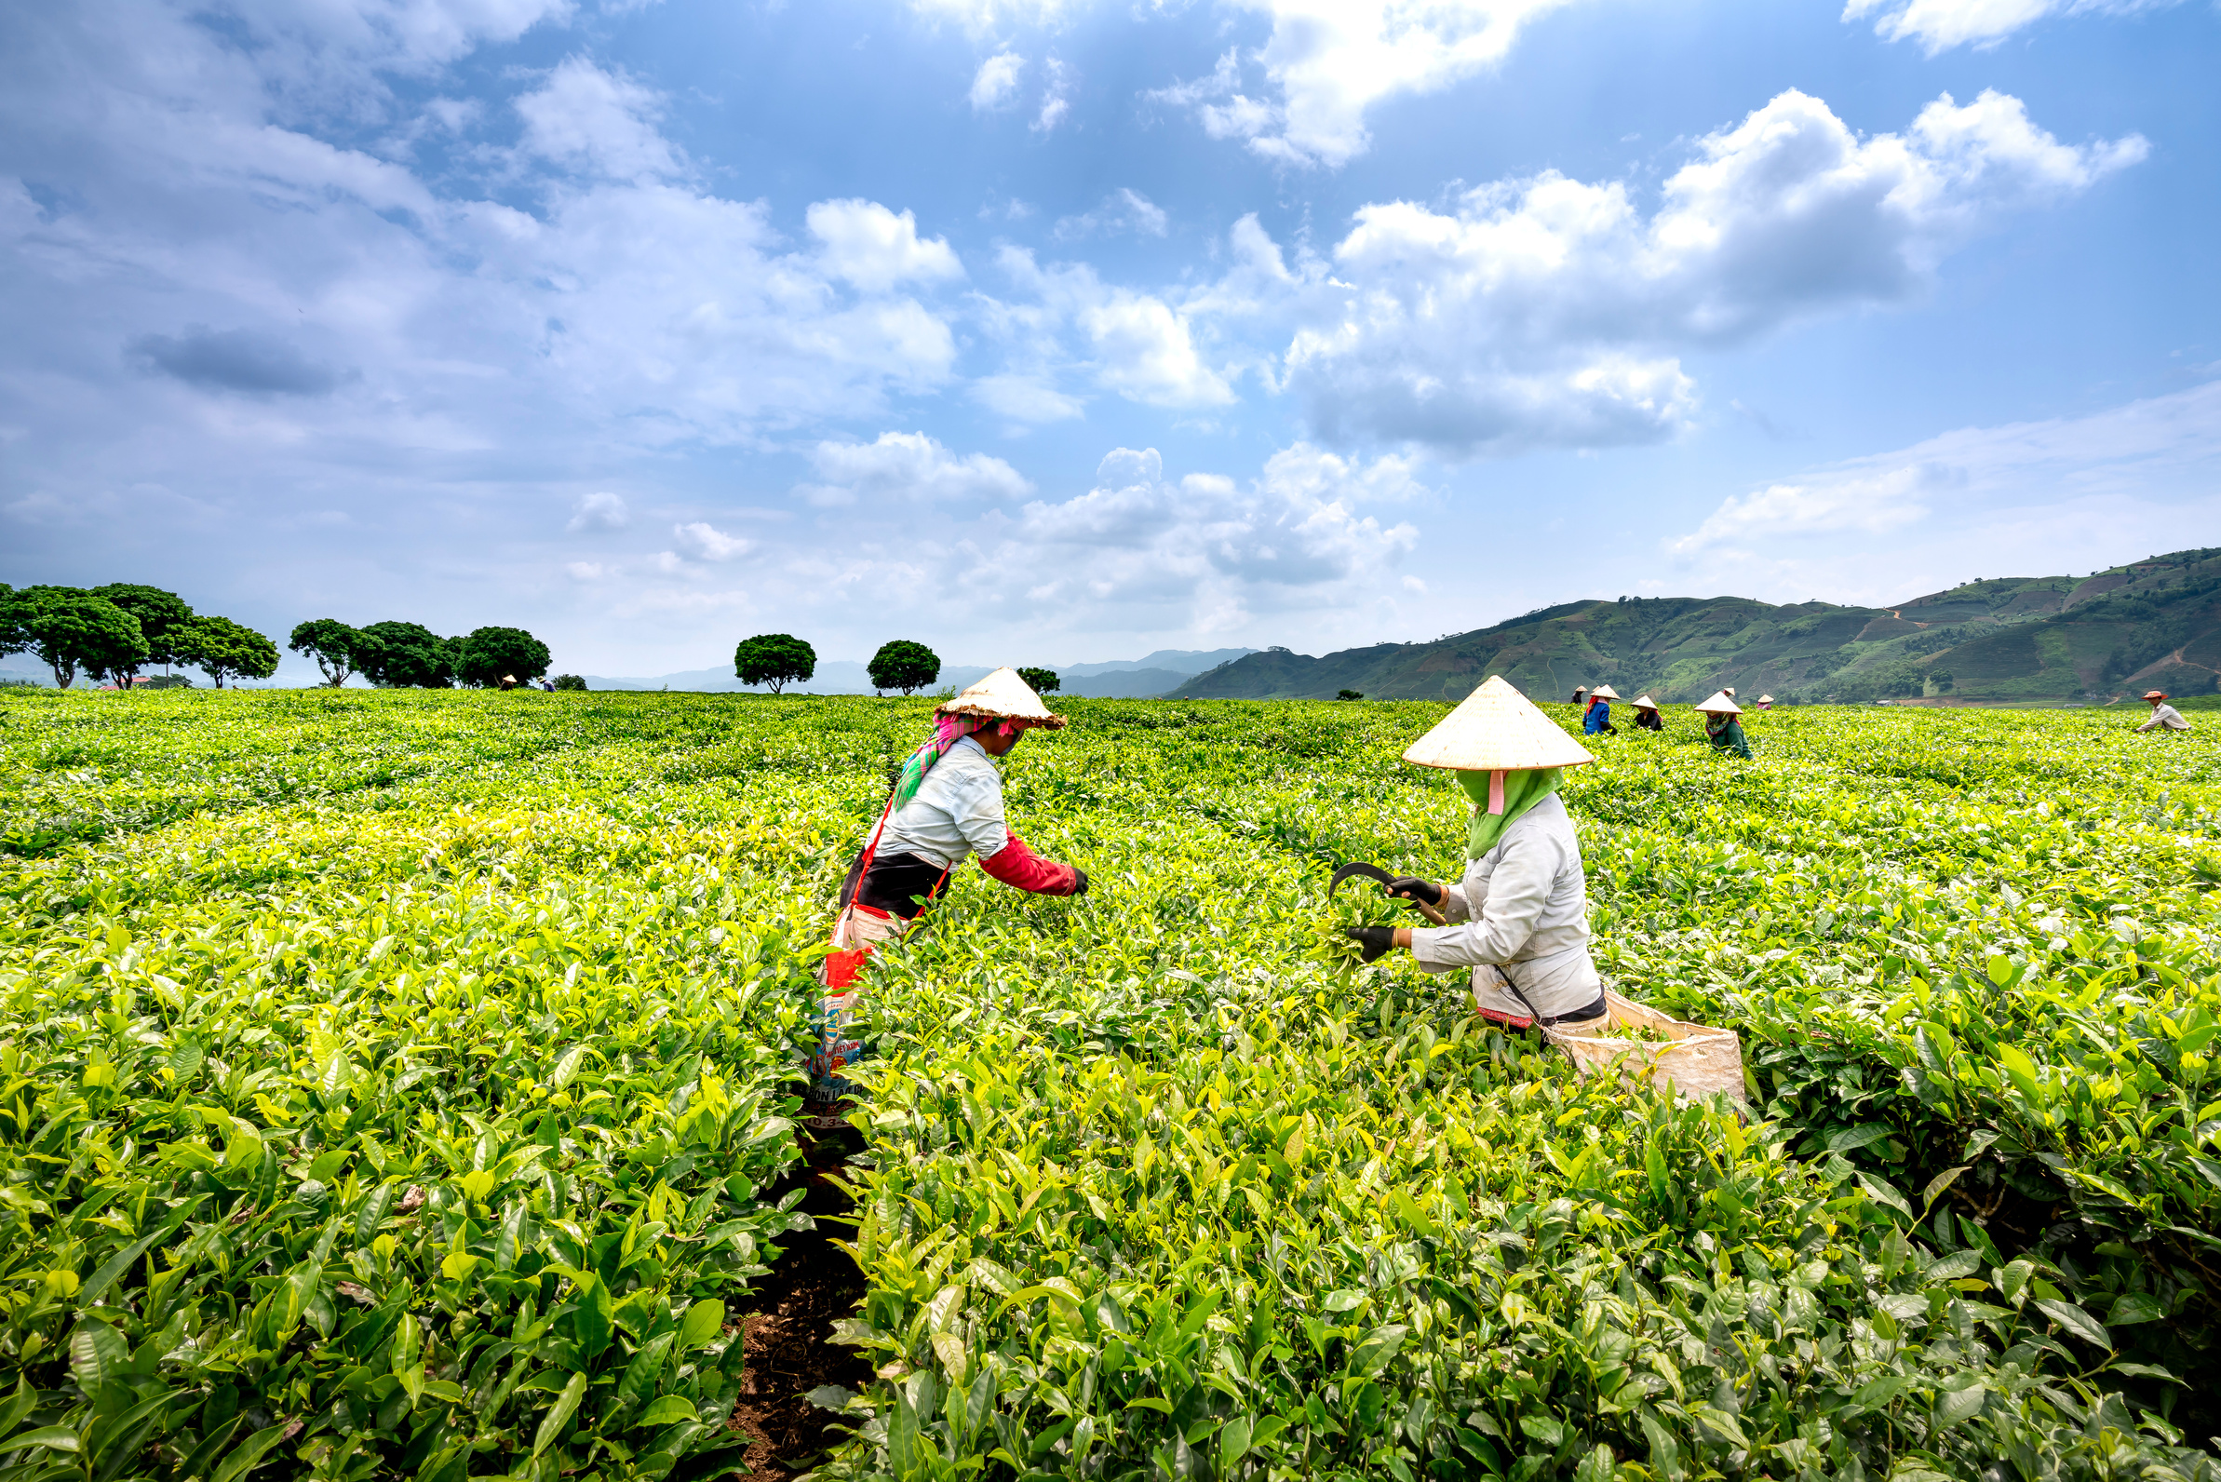

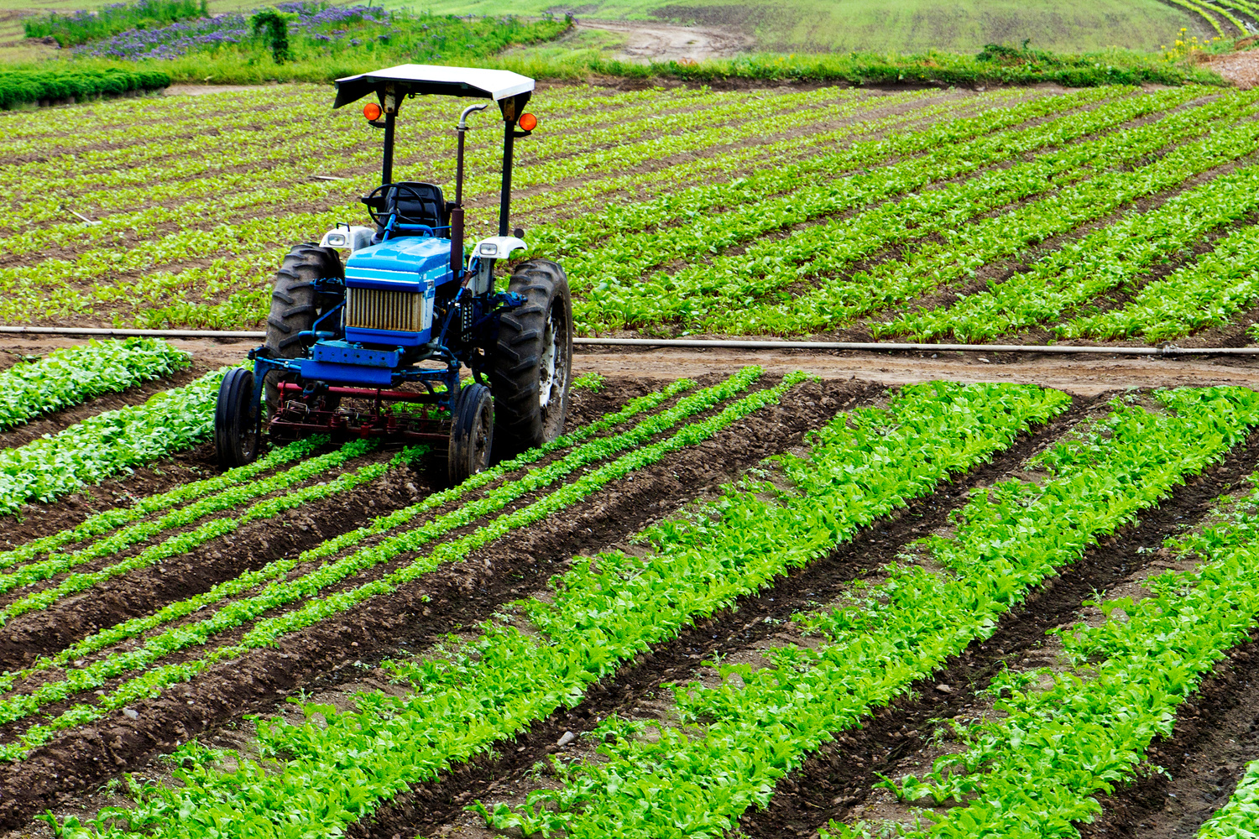
STAKEHOLDERS
Kenya Farmers Associations.
Small-scale Farmers:
Government Agencies:
Agricultural Traders and Middlemen:
Financial Institutions:
Consumers:

Slide 6
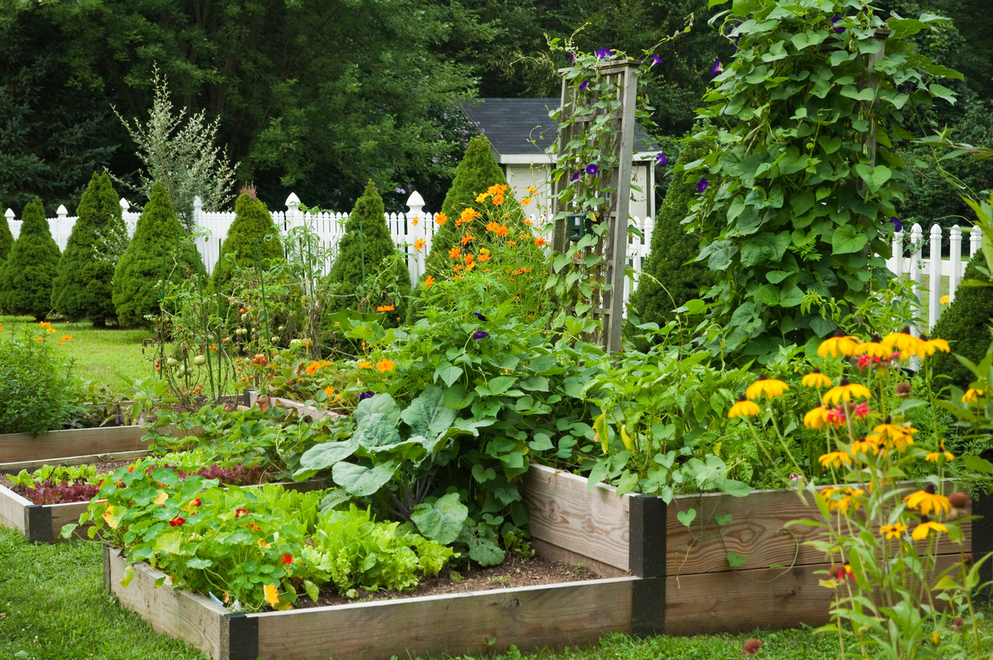


PROBLEM STATEMENT
Farmers in Kenya grapple with significant price discrepancies between what they receive for their produce and what consumers pay. These disparities arise due to inefficient market systems and intermediaries profiting from inconsistent pricing. Despite agriculture’s importance to the country’s economy, farmers struggle to secure fair rates. To address this, a robust price forecasting system leveraging historical and real-time data, along with machine learning models, is essential. Such a system would benefit farmers by providing accurate pricing forecasts, enhancing market transparency, and enabling informed decision-making across the agricultural value chain.

Slide 7


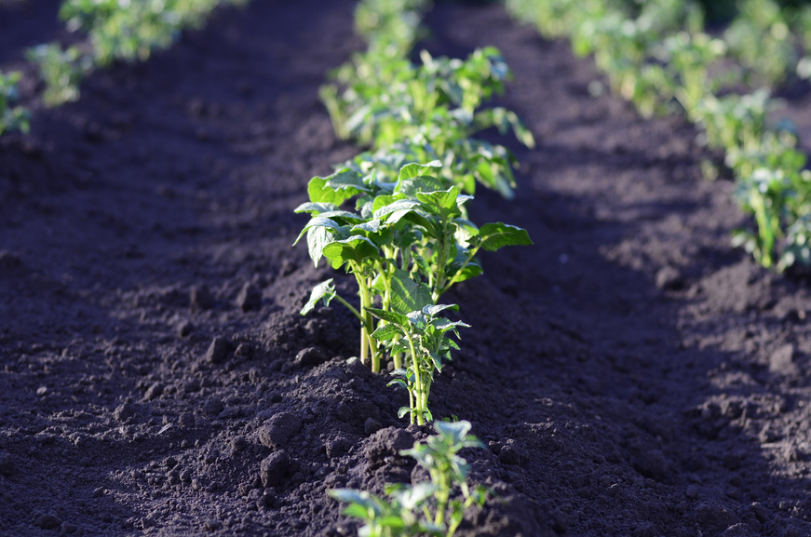
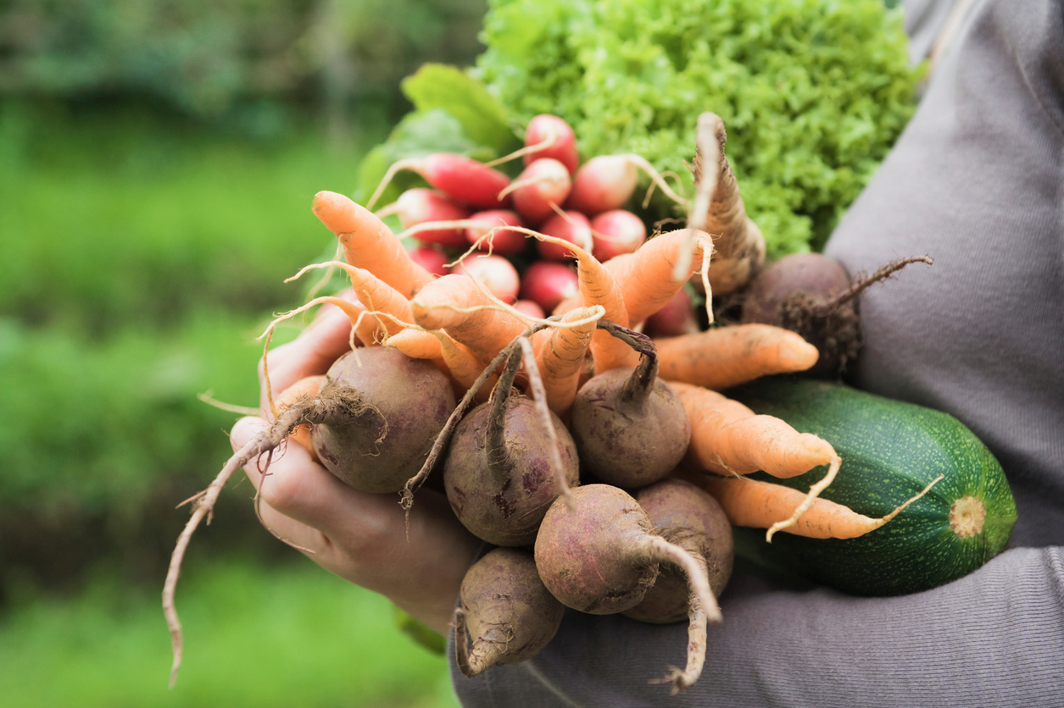
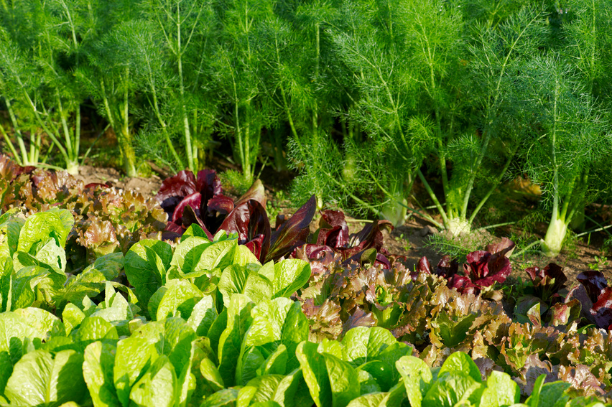
OBJECTIVES
Creating machine learning models to forecast crop output pricing using variables such as location, time, supply dynamics, and currency fluctuations. Developing a user-friendly interface for farmers to receive predicted pricing updates and market segmentation data.
Using historical agricultural commodity prices and CBK currency data to create accurate forecasting models.
Farmers will receive training and support in order to efficiently use the price forecasting system.

Slide 8
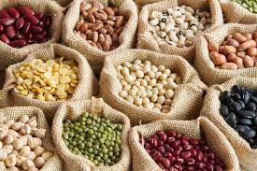
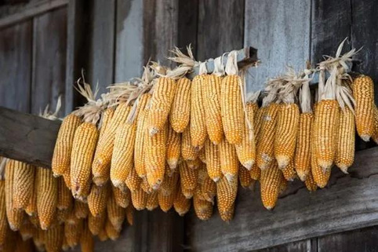
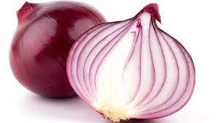
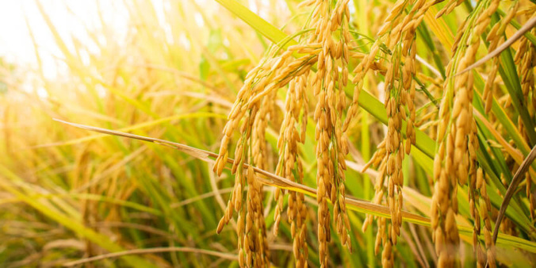

EXPLORATORY DATA ANALYSIS
We considered the overall demand for these crops in Kenya. Beans, dry maize, onion, and rice are staples in Kenyan households, with consistent consumption patterns since predicting prices for widely consumed crops directly impacts farmers’ livelihoods. These crops play vital roles in Kenya’s economy. Beans are exported, dry maize ensures food security, onions serve both local consumption and export, and rice is import-dependent.

Slide 9
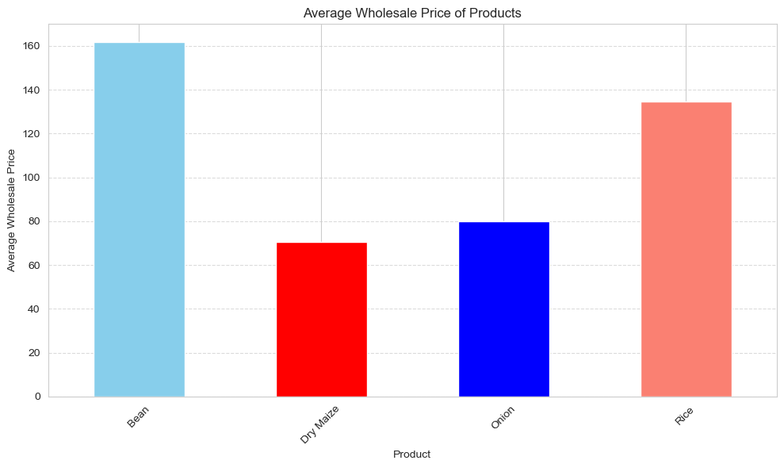
The Bean bar is significantly taller, reaching up to approximately 150 on the y-axis. This indicates that Beans have a higher average wholesale price. The Dry Maize bar is shorter, reaching up to approximately 60 on the y-axis. Dry Maize has a lower average wholesale price compared to Beans. Hence beans are priced higher on average than Dry Maize.

Slide 10
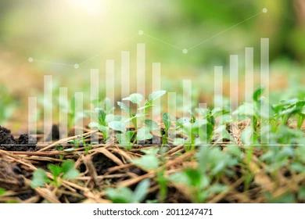
STATISTICAL SUMMARY
Dataset: 60,969 entries of wholesale prices and supply volumes. Mean price: $107.55, average supply volume: ~8,651 units. Prices range: $0.01 to $120,000, with most falling between $54.55 and $130.00. Supply volumes: 0 to 100 million units. Data spans May 24, 2021, to April 24, 2024, median date: August 29, 2022. USD exchange rate mean: $123.38, range: $107.35 to $163.00, indicating potential currency fluctuations. Provides detailed snapshot of wholesale pricing dynamics for analysis of trends and market behavior.

Slide 11
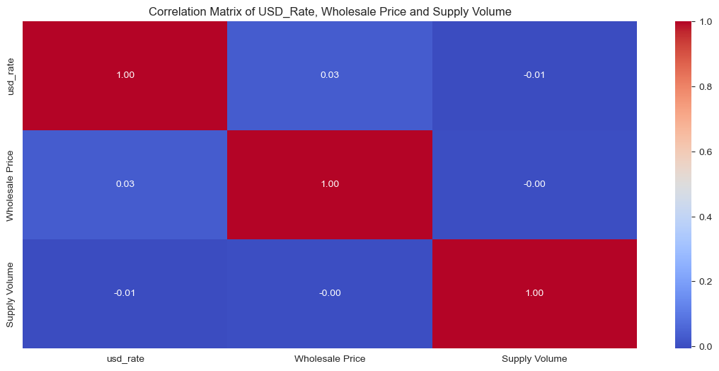
Correlation analysis reveals minimal impact of USD rate fluctuations on wholesale prices (0.031) and vice versa. Additionally, weak correlations between USD rate/wholesale price and supply volume suggest little influence on supply dynamics. Overall, changes in USD rates and wholesale prices have minimal discernible impact on supply volume fluctuations.

Slide 12
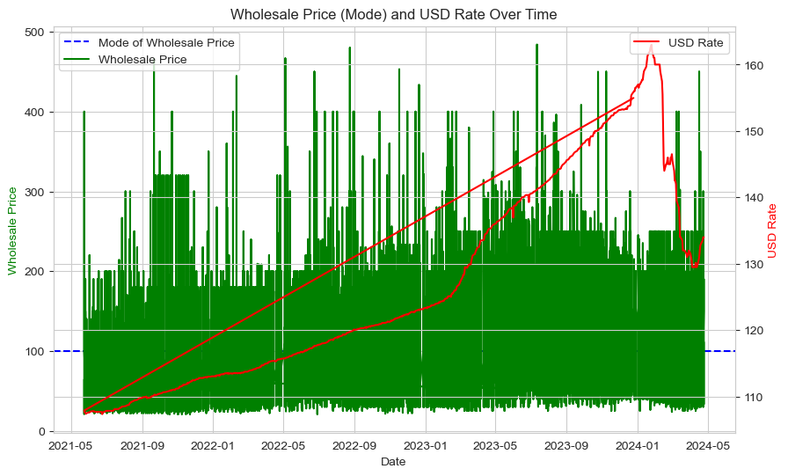
WHOLESALE PRICE A RATE OVER AND USD
USD rate initially strengthens from May 2021 to early 2023, peaking around 150, likely due to economic shifts. Subsequently, heightened volatility reflects increased market uncertainty. Stronger dollar inflates import costs, while a weaker one may spur demand. Understanding these trends is crucial for interpreting wholesale market fluctuations and guiding strategic decisions.

Slide 13
The analysis of USD rate trends unveils a nuanced narrative of currency dynamics. Initially, from May 2021 to early 2023, a steady uptrend reflects the strengthening of the U.S. dollar against other currencies, attributed to diverse economic influences. However, a notable peak around early 2023, reaching approximately 150, marks a pivotal moment likely triggered by significant economic shifts. Subsequently, the USD rate displays heightened volatility, characterized by erratic fluctuations, indicative of increased market uncertainty. This unpredictability underscores the intricate relationship between the USD rate and wholesale prices, where a stronger dollar typically inflates import costs, while a weaker one might spur demand through lowered prices. Understanding these trends not only provides crucial insights into currency dynamics but also offers valuable context for interpreting wholesale market fluctuations and guiding strategic decisions.

Slide 14
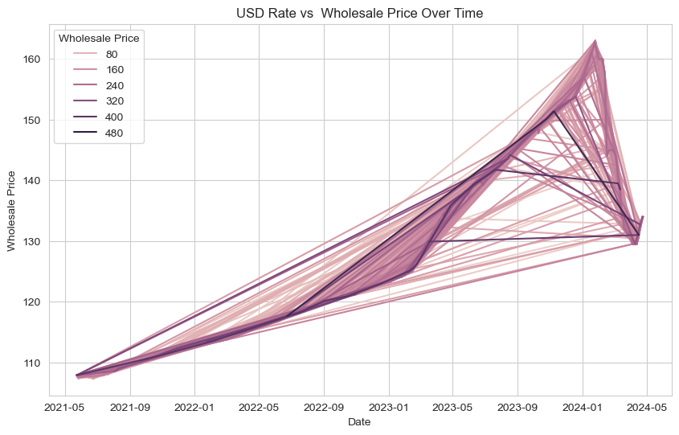
USD RATE VS WHOLESALE PRICE OVER TIME
Analysis shows consistent overall upward trajectory in USD rate across products. Lines diverge over time, indicating unique impact on each product. Higher-priced products exhibit greater sensitivity to USD fluctuations. Reflects complex interaction between currency trends and wholesale pricing dynamics, mirroring broader market and economic conditions.

Slide 15
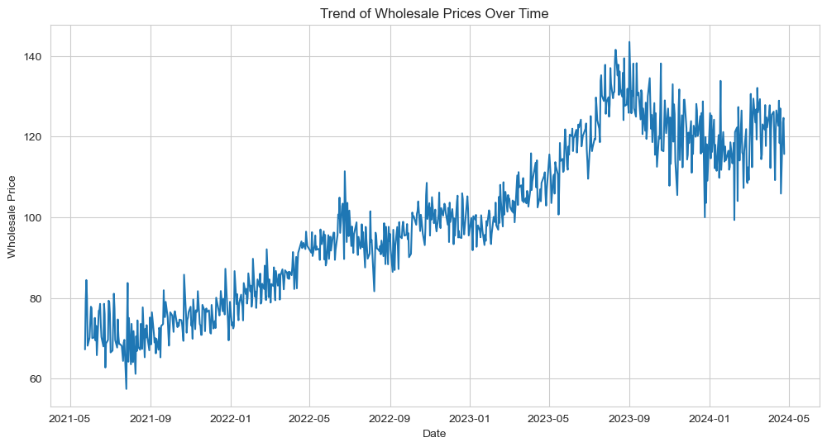
The analysis of wholesale price trends unveils an overarching upward trajectory, initially marked by a gradual increase. However, periods of volatility punctuate the trend, suggesting external influences such as market dynamics or fluctuations in supply and demand. The observation of a peak followed by a decline hints at potential shifts in market conditions or underlying economic factors impacting pricing dynamics.

Slide 16
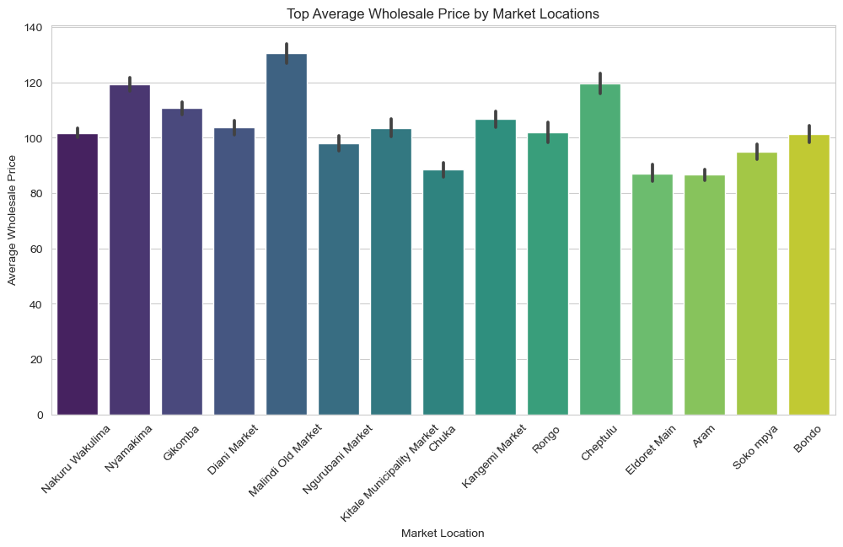
Comparison on Supply Volume and Wholesale Prices
Market Segmentation: The distinct price ranges suggest market segmentation. Businesses can tailor their strategies based on these segments.
Competitive Landscape: Understanding why certain markets command higher prices can inform competitive strategies.
Consumer Behavior: Investigating consumer preferences and spending patterns in each location can reveal opportunities for businesses.

Slide 17
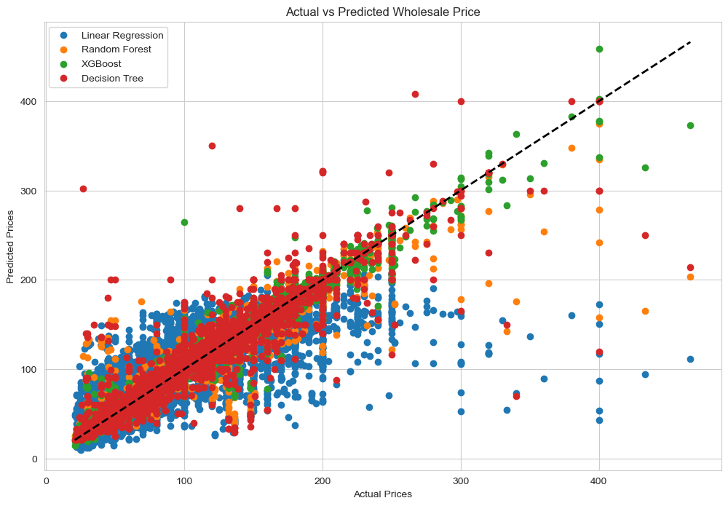
MODELING
The spread of data points around the dashed line indicates the variability in predictions.
Linear Regression and Decision Tree have wider spreads, suggesting less accurate predictions.
Random Forest and XGBoost have narrower spreads, indicating better prediction performance.

Slide 18
The analysis of data points around the dashed line reveals the variability in predictions, with a wider spread suggesting less precise estimations. Comparatively, linear regression and decision tree models exhibit broader spreads, indicating less accurate predictions. In contrast, random forest and XGBoost models display narrower spreads, implying superior prediction performance. This discrepancy suggests that random forest and XGBoost models are better equipped to handle the complexities of the data and generate more precise predictions, potentially due to their ability to capture nonlinear relationships and interactions among variables more effectively.

Slide 19
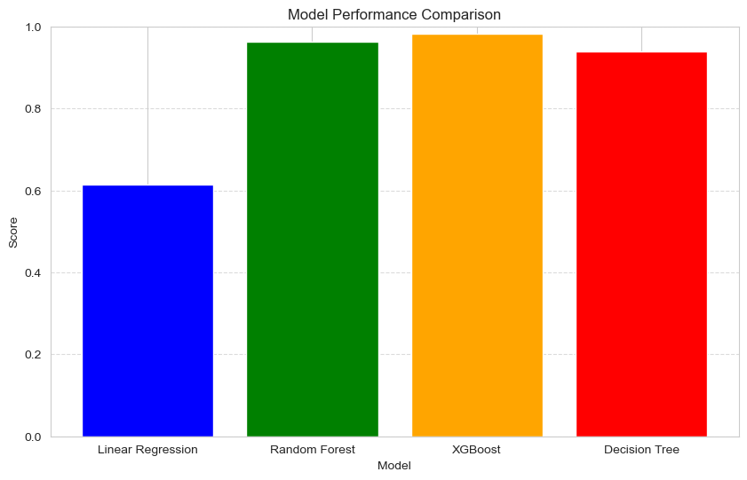
MODEL PERFORMANCE COMPARISON
It's evident that the Random Forest and XGBoost outperform the Linear Regression and Desicion Tree models in terms of predictive performance. Both Random Forest and XGBoost achieved high scores of approximately 0.9, indicating strong predictive capabilities.
While Linear Regression scored approximately 0.5, suggesting moderate performance, it falls behind the other models significantly.
Desicion tree model , with a score of approximately 0.8, demonstrates good performance but is slightly lower than both Random Forest and Decision Tree.

Slide 20
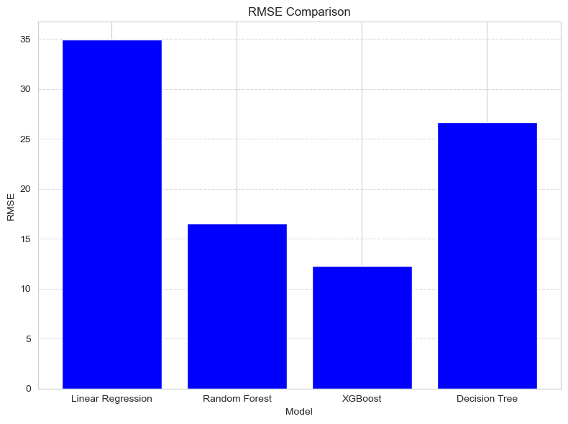
MODEL PERFORMANCE COMPARISON
Linear Regression:
RMSE: 34.96
Random Forest:
RMSE: 16.51
XGBoost:
RMSE: 12.26
Decision Tree:
RMSE: 26.67
'
XGBoost model demonstrates the lowest RMSE, suggesting it provides the most accurate predictions among the evaluated models

Slide 21
It's evident that the Random Forest and XGBoost outperform the Linear Regression and Desicion Tree models in terms of predictive performance. Both Random Forest and XGBoost achieved high scores of approximately 0.9, indicating strong predictive capabilities.
While Linear Regression scored approximately 0.5, suggesting moderate performance, it falls behind the other models significantly.
Desicion tree model , with a score of approximately 0.8, demonstrates good performance but is slightly lower than both Random Forest and Decision Tree.
Therefore, from this comparison the Random Forest and XGBoost are the most effective models for the given task, with Random Forest having a slight edge due to its ensemble nature, which often enhances robustness and generalizability.

Slide 22
CONCLUSIONS
The interpretation of results from the comparison of different machine learning models in agricultural markets underscores the critical role of data-driven insights in shaping decision-making processes and driving positive outcomes. Agriculture is inherently influenced by various factors such as weather patterns, soil conditions, market demand, and governmental policies. Therefore, having accurate predictive models can provide invaluable guidance to stakeholders involved in agricultural activities.

Slide 23
RECOMMENDATIONS
Seasonal Planning:
Farmers and traders analyze historical data to identify seasonal trends in demand and pricing for crops.
Crop rotation and timing are planned to optimize yields based on these trends.
Marketing strategies are adjusted during peak seasons to maximize profits.
Diversification Strategies:
Farmers diversify crop portfolios to spread risks related to price volatility and climate uncertainties.
Exploring new markets and adding value to products can reduce dependency on fluctuating prices.
Policy Interventions:
Governments implement price stabilization mechanisms (e.g., price floors, subsidies) to protect farmers and maintain affordable prices.
Market information systems empower informed decision-making and reduce information asymmetry.
Infrastructure development enhances market access and reduces losses.
Investment Opportunities:
Investors can explore value chain investments (production, processing, storage, transportation, marketing) to contribute to sectoral growth.
Analyzing regional market dynamics helps identify high-growth markets.
Technology-driven solutions improve productivity and sustainability.

Slide 24

THANK YOU

